Slide 1
09/24 Paper Presentation
By Zhenyi Tang
Notes:
Train a feed-forward network F to model the conditional distribution
This network basically has two parts, one part is to estimate the next frame by warping the current frame if the optical flow between consecutive frames is known
This estimation would be largely correct except for the occluded areas.
So naturally, we need another part to estimate the occluded area, which is the hallucinated image
The value of m will help us to leverage the percentage we use for optical flow and hallucination

Slide 2
Conditional Generative Adversarial Nets Mehdi Mirza mirzamom@iro.umontreal.ca Simon Osindero osindero@yahoo-inc.com

Slide 3
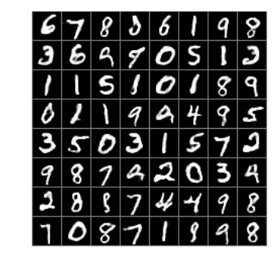
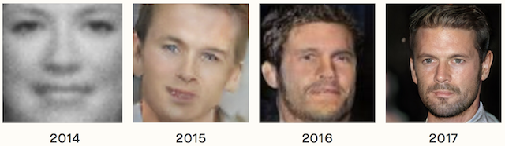
Generative adversarial networks
Can generate realistic examples across a range of problem domains
image-to-image translation
translating photos of summer to winter
generate photorealistic photos of objects that even humans cannot tell are fake

Slide 4
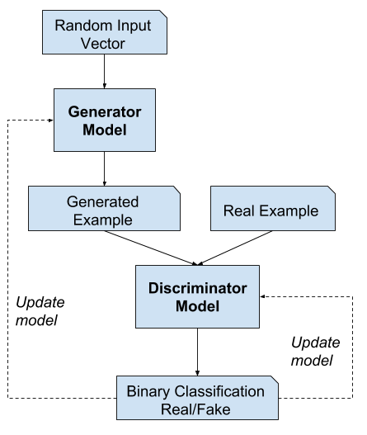
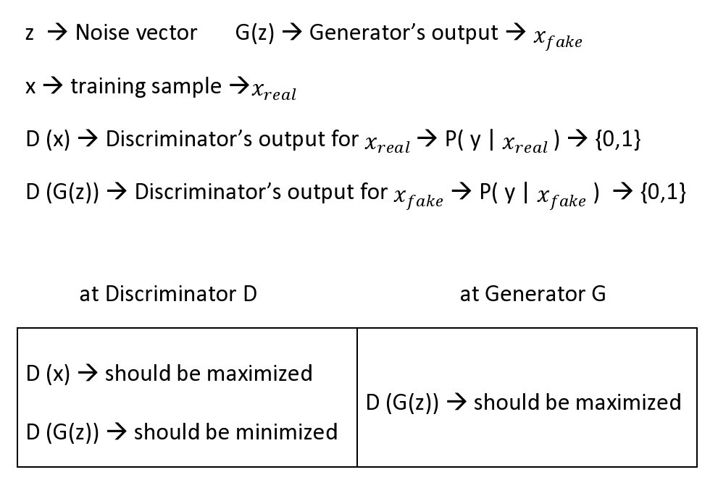
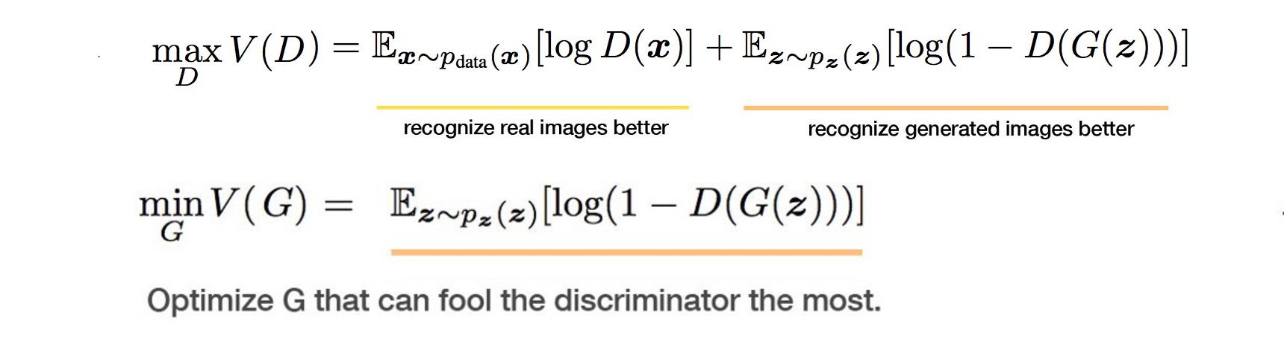
Generative adversarial networks
Notes:
Log: cross entropy p log(q). For real image, p (the true label for real images) equals to 1. For generated images, we reverse the label (i.e. one minus label)
Discriminator network runs twice (one for real , one for fake) before it calculates the final loss while generator runs only once.
Discriminator wants to maximize the chance to recognize real images as real and generated images as fake. i.e. the maximum likelihood of the observed data.
On the generator side, its objective function wants the model to generate images with the highest possible value of D(x) to fool the discriminator
In training, we fix the generator model’s parameters and perform a single iteration of gradient descent on the discriminator using the real and the generated images.
Then we switch sides.
Fix the discriminator and train the generator for another single iteration.
We train both networks in alternating steps until the generator produces good quality images.

Slide 5
Conditional generative adversarial networks
Unconditional VS. conditional
Unconditioned generative model: no control on modes of the data being generated
Conditional
Avoid mode collapse problem
Can direct the data generation process
Scale # predicted output categories
One-to-many mappings
Condition based on:
class labels
some part of data for inpainting
even data from different modality
Eg. one to many mapping is instantiated as a conditional predictive distribution.

Slide 6
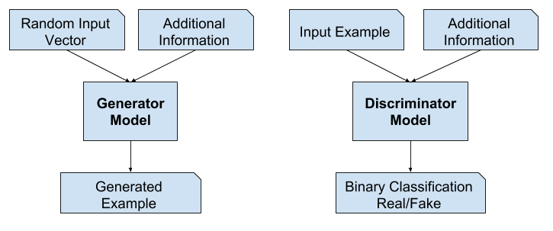
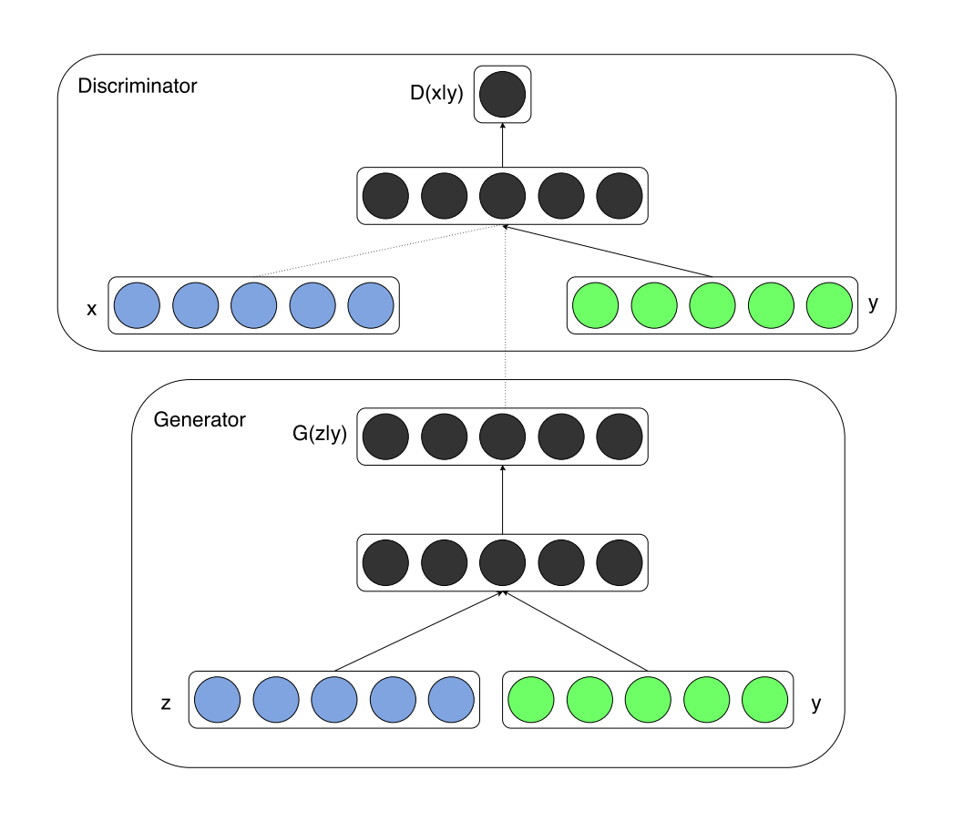
Conditional generative adversarial networks
x and y are presented as inputs
to a discriminative function
Prior input noise x and additional info y are
combined in joint hidden representation
Notes:
Why this different structure
Discriminator: see real data, to do real data distribution estimation
Generator: can take anything. Feed x and y to hidden representation to help constrain to certain space.

Slide 7
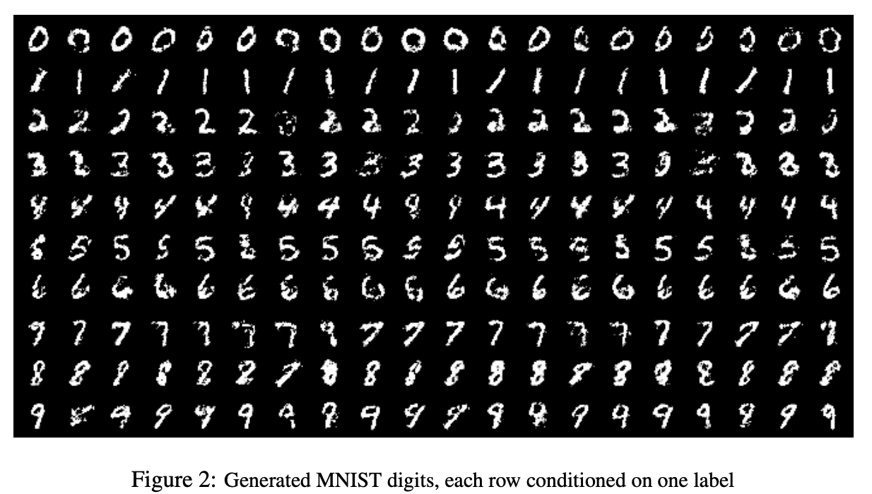
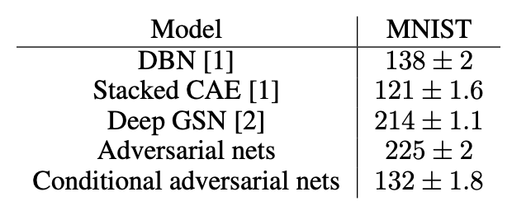
Application 1 – Generate MNIST images
MNIST images conditioned on their class labels
Parzen window-based (kernel density estimation)
log-likelihood estimates for MNIST
Higher is better
Not ideal, worse than unconditional GAN
Needs further exploration of hyper-parameter
space and architecture
Each row is conditioned on one label
Each column is a different generated sample

Slide 8
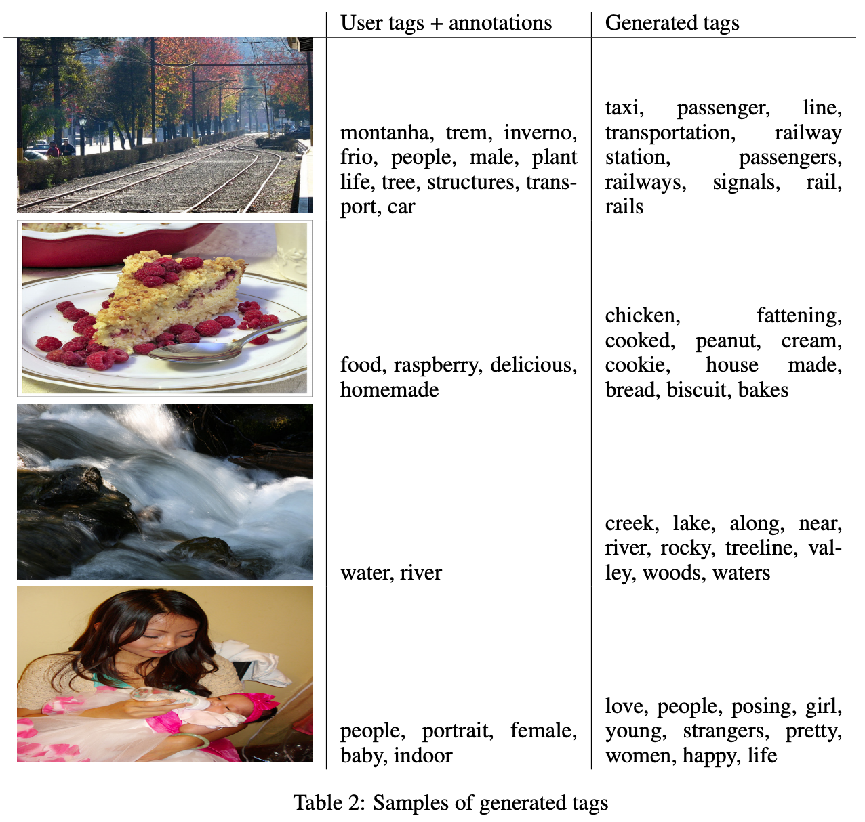
Application 2 - Automated tagging of images
Generate a (possibly multi-modal) distribution of tag-vectors conditional on image features
Image features: pre-train a convolutional model
World representation: train a skip-gram model using a corpus of text

Slide 9
Application 2: To Improve
Images with multiple tags were repeated inside the training set once for each associated tag =>
use multiple tags at the same time
effectively posing generative problem as one of ‘set generation’
Construct a joint training scheme to learn the language model; learn a language model for suited for the specific task

Slide 10
Video-to-Video synthesis paper presentation Ting-Chun Wang¹ , Ming-Yu Liu¹ , Jun-Yan Zhu² , Guilin Liu¹ , Andrew Tao¹ , Jan Kautz¹ , Bryan Catanzaro¹ ¹NVIDIA, ²MIT CSAIL {tingchunw,mingyul,guilinl,atao,jkautz,bcatanzaro}@nvidia.com, junyanz@mit.edu

Slide 11
Introduction
Define the task
Learn a mapping function that can convert an input video to an output video
Other forms:
future video prediction
unconditional video synthesis - learns a generator for converting a random vector to a video
Why is it useful
Scientific interest
Applications in computer vision, robotics, and computer graphics
Eg. approximate visual dynamics of the world to train agent in model-based reinforcement learning, with less amount of real experience data
can generate realistic videos without explicitly specifying scene geometry, materials, lighting, and dynamics

Slide 12
Baselines
pix2pixHD
state-of-the-art image-to-image translation approach
when apply to the video-to-video synthesis task, process input videos frame-by-frame
Convst
built on the coherent video style transfer by replacing the stylization network with pix2pixHD
key idea: warp high-level deep features using optical flow for achieving temporally coherent outputs
feed in ground truth optical flow is impractical for real applications. In contrast, our model estimates optical flow from source videos
https://tcwang0509.github.io/vid2vid/paper_gifs/cityscapes_comparison.gif

Slide 13
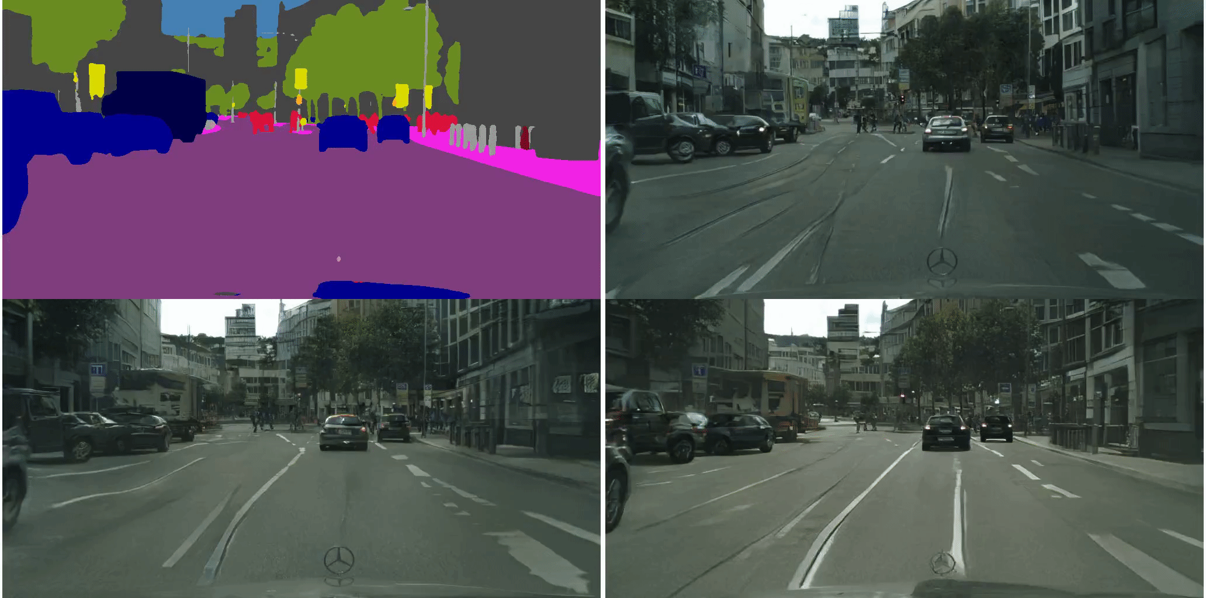

Slide 14
Techniques
Sequential generator
Feed-forward network F
Conditional image discriminator
Conditional video discriminator
Multimodal synthesis

Slide 15
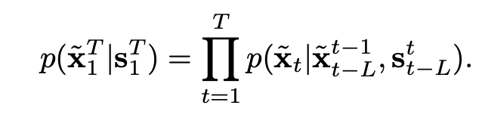
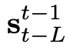
Sequential generator
Generated t-th frame
Markov assumption
Video frames can be generated sequentially
Generation of t-th frame only depends on
1) current source frame
2) past L source frames
3) past L generated frames
*In experiments, L=2
Past L generated frame
Current source frame s_{t} + past L source frames
Notes:
Conditional distribution

Slide 16
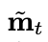
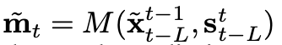
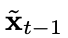
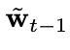
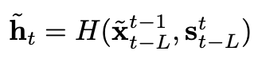
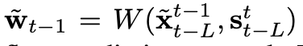
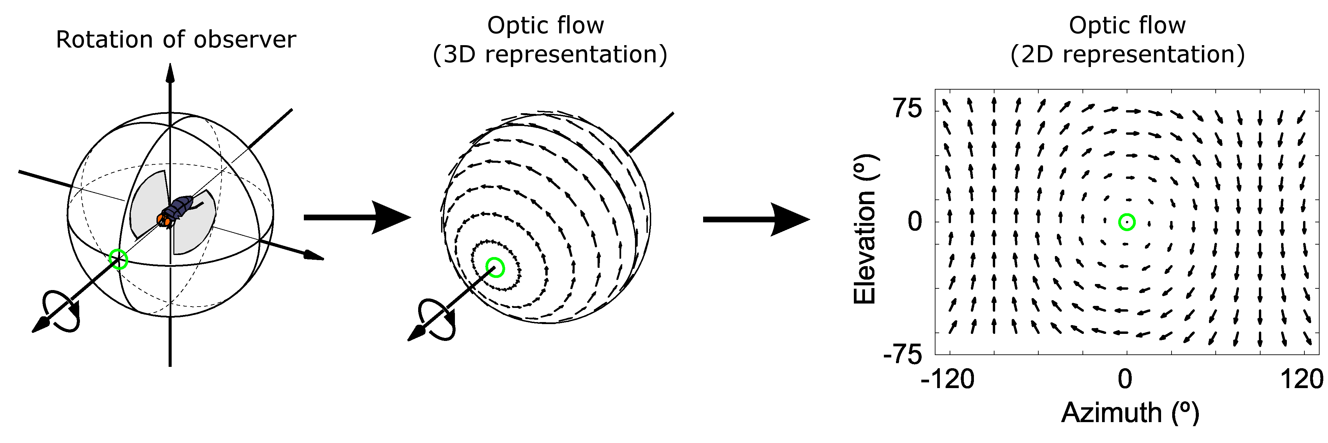
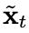
Feed-forward network F
Occlusion mask
soft instead of binary: better handle the “zoom in” scenario. Eg: blurry if only use warped images
Occlusion mask with continuous values [0,1]
M: mask prediction network
Image of all ones
Warp based on
Feed-forward network F
Optical flow: pattern of apparent motion of objects, surfaces, and edges in a visual scene caused by the relative motion between an observer and a scene
Element-wise product operator
Estimated optical flow from to
W: optical flow network
Hallucinated image, synthesized by H
H: generator
Notes:
Train a feed-forward network F to model the conditional distribution
This network basically has two parts, one part is to estimate the next frame by warping the current frame if the optical flow between consecutive frames is known
This estimation would be largely correct except for the occluded areas.
So naturally, we need another part to estimate the occluded area, which is the hallucinated image
The value of m will help us to leverage the percentage we use for optical flow and hallucination

Slide 17
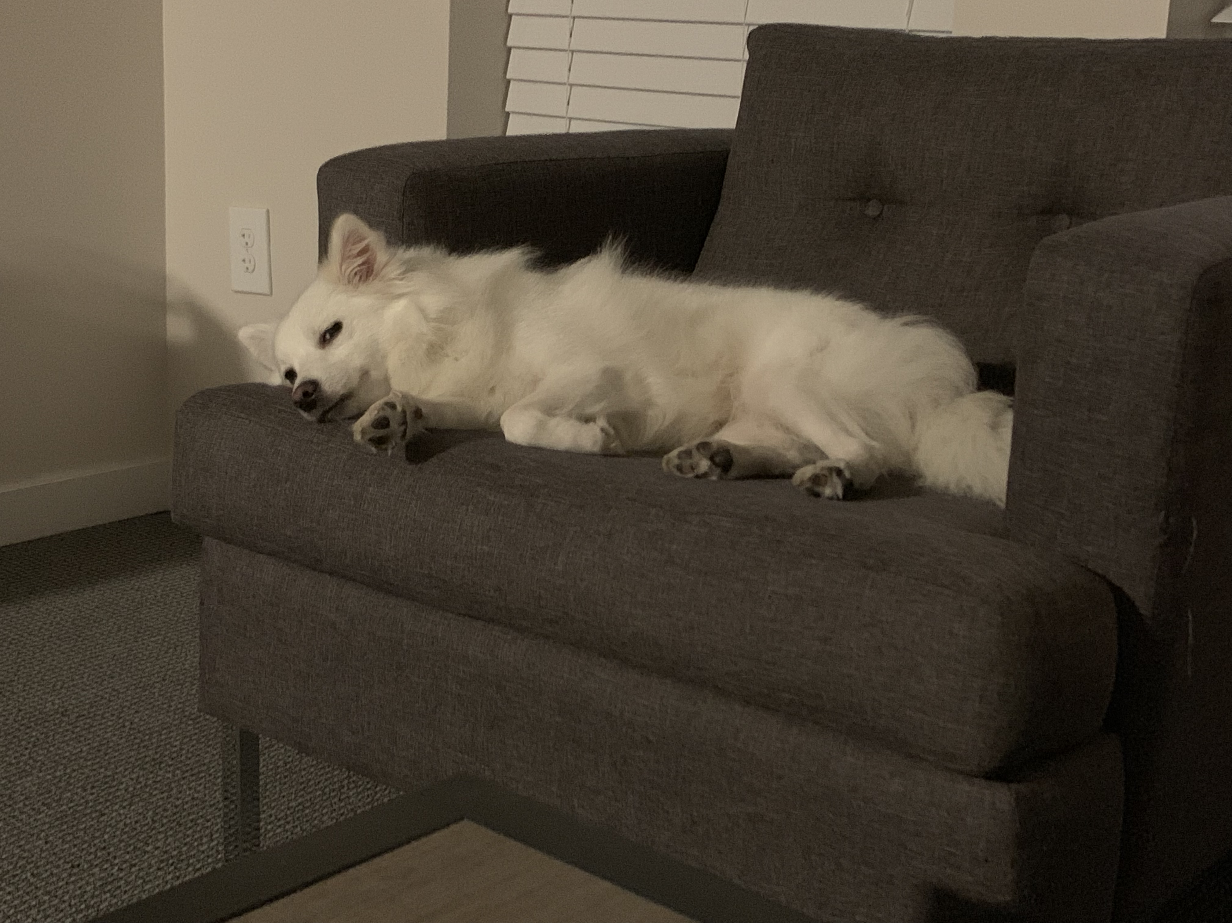
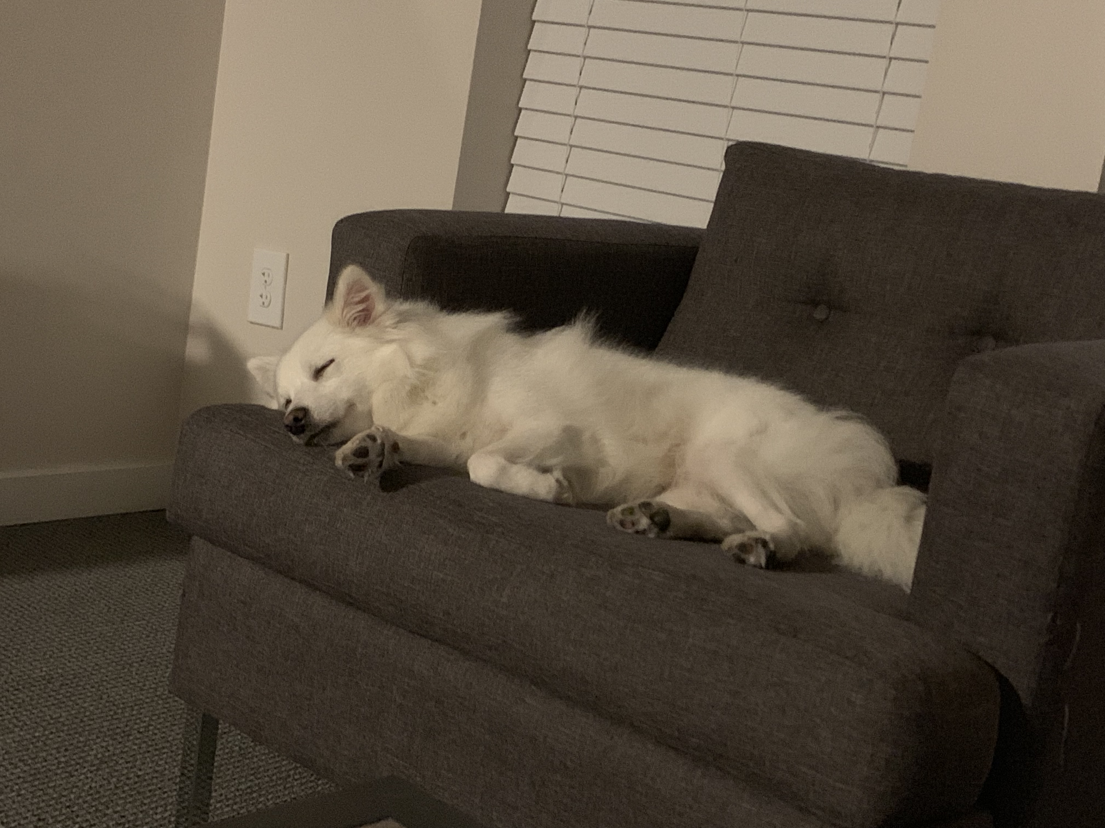

Slide 18
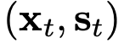
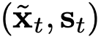
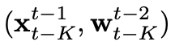
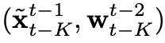
Conditional discriminator
Conditional image discriminator D_{I}
purpose of D_{I} is to ensure that each output frame resembles a real image given the same source image
Eg. Output 1 for a true pair
Output 0 for a fake pair
Conditional video discriminator D_{v}
purpose of D_{v} is to ensure that consecutive output frames resemble the temporal dynamics of a real video given the same optical flow
Eg. Output 1 for a true pair
Output 0 for a fake pair

Slide 19
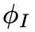
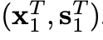
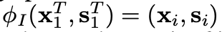
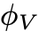
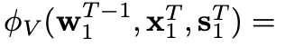
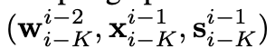
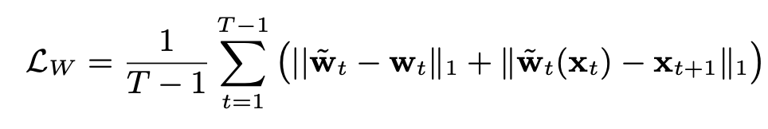
Learning objective function
Random sampling operator
randomly samples a pair of images
from
L_{I}: image-conditional GAN loss
L_{v}: video GAN loss L
L_{w}: flow loss L_{W}
Random sampling operator
randomly retrieves K consecutive frames
Notes:
X real image, x~ generated frame, s source image

Slide 20
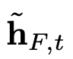
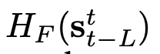
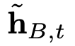
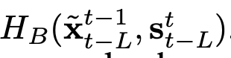
Foreground-background prior
foreground object often has a large motion
& only occupies a small portion of the image
optical flow estimation difficult
has to synthesize most of the foreground content from scratch
Foreground model
Background model
background motion can be modeled as a global transformation in general
where optical flow can be estimated quite accurately.
background region can be generated accurately via warping
only needs to synthesize the occluded area

Slide 21
Results
Video to video synthesis
Multimodal results
Semantic manipulation
Sketch-to-video synthesis for face swapping
Pose-to-video synthesis for human motion transfer
Future video prediction
https://youtu.be/5zlcXTCpQqM

Slide 22
Future work
Fail situation
Synthesize turning cars (insufficient information in label maps)
Improve: add additional 3D cues, such as depth maps
Consistency
Does not guarantee object has a consistent appearance across the whole video, eg. Car change color gradually
Improve: use object tracking information is used
Artifact
When perform semantic manipulations such as turning trees into buildings
Improve: train model with coarser semantic labels, as the trained model would be less sensitive to label shapes

Slide 23
Thank you!

